Slide 1
Optimising Galaxy Formation and Evolution Models
Mawson Sammons
Supervisor: Rodrigo Tobar

Slide 2
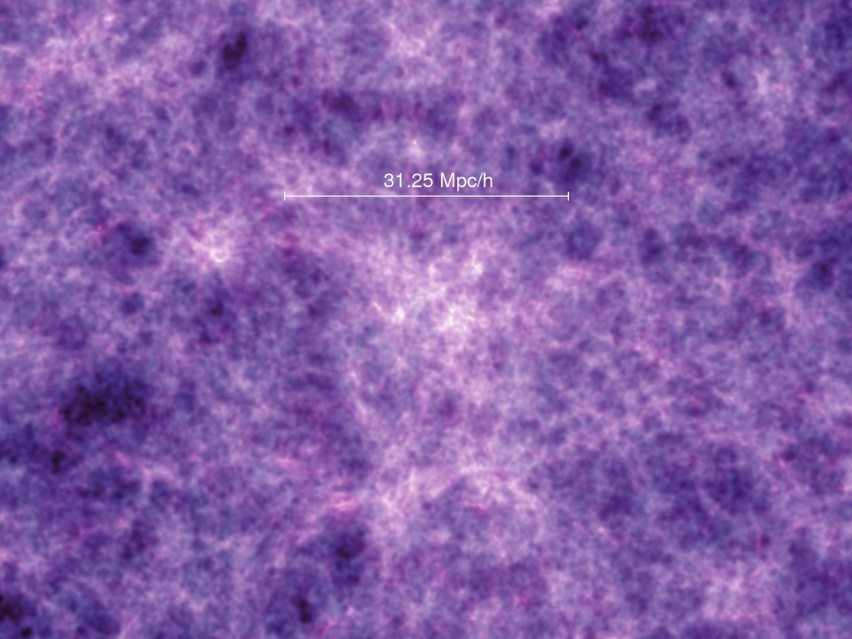
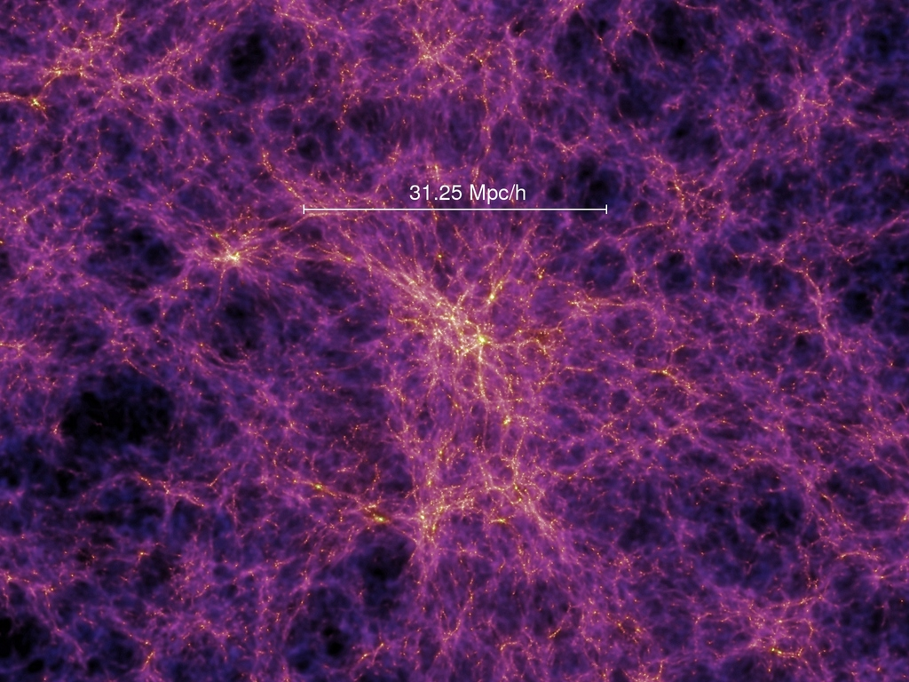
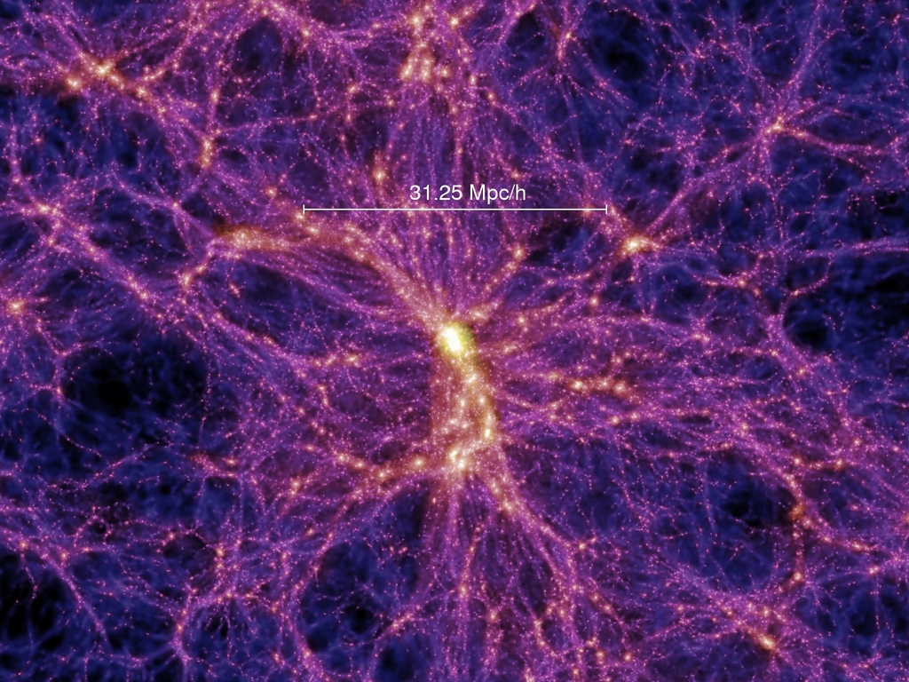
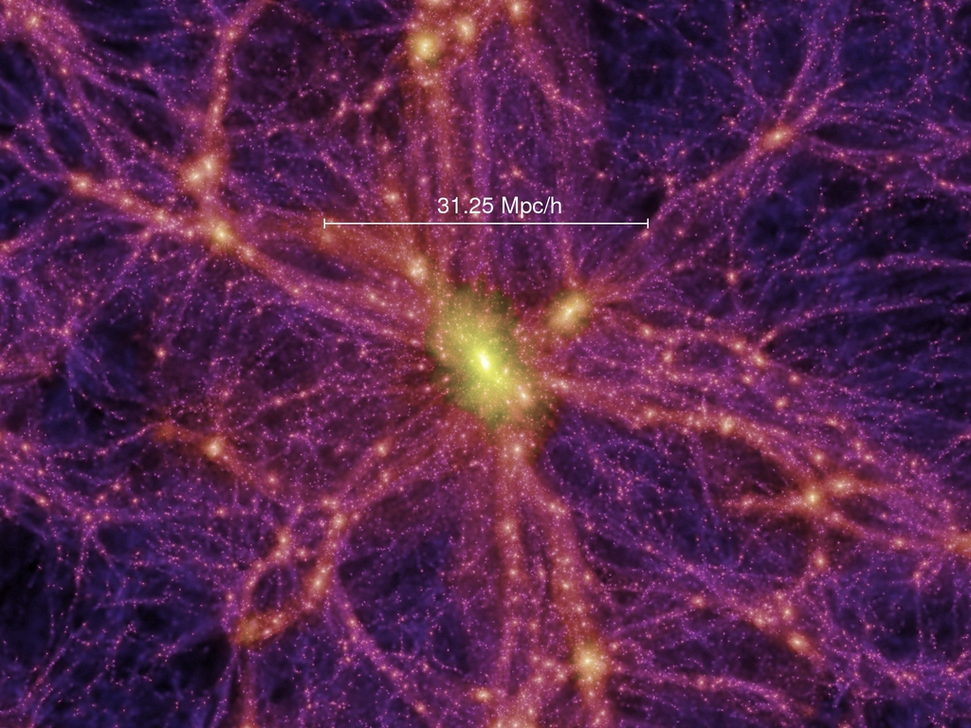
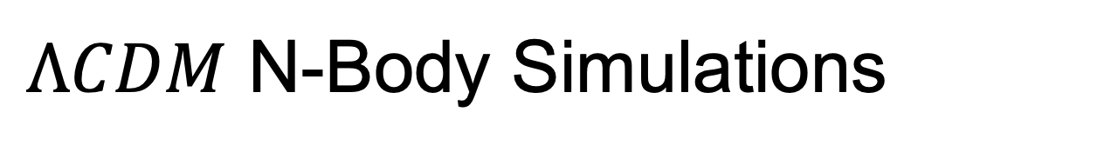
$ΛCDM$ N-Body Simulations

Slide 3
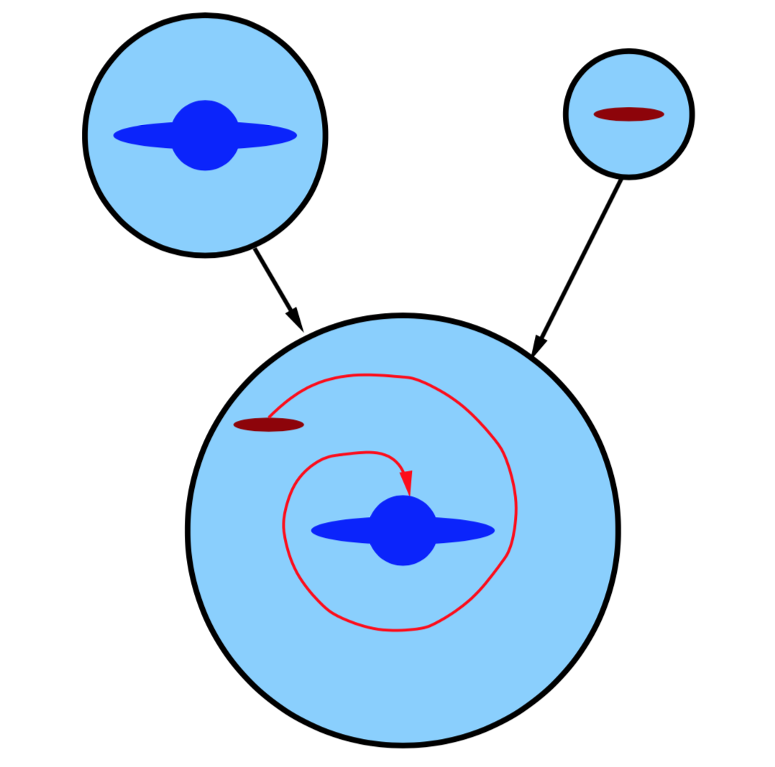
Semi-Analytical Models (SAMs)
SHARK
Physical Processes:
Gas cooling in halos
Stellar formation
Stellar feedback
Black hole feedback
Galaxy mergers
Disk instabilities
Photoionisation feedback
Environmental effects
Etc…

Slide 4
References
Springel, Volker, Simon D. M. White, Adrian Jenkins, Carlos S. Frenk, Naoki Yoshida, Liang Gao, and Julio Navarro et al. 2005. "Simulations Of The Formation, Evolution And Clustering Of Galaxies And Quasars". Nature 435 (7042): 629-636. doi:10.1038/nature03597.
Ruiz, Andrés N., Sofía A. Cora, Nelson D. Padilla, Mariano J. Domínguez, Cristian A. Vega- Martínez, Tomás E. Tecce, and Álvaro Orsi et al. 2015. "CALIBRATION OF SEMI-ANALYTIC MODELS OF GALAXY FORMATION USING PARTICLE SWARM OPTIMIZATION". The Astrophysical Journal 801 (2): 139. doi:10.1088/0004-637x/801/2/139.
Lagos, Claudia del P, Rodrigo J Tobar, Aaron S G Robotham, Danail Obreschkow, Peter D Mitchell, Chris Power, and Pascal J Elahi. 2018. "Shark: Introducing An Open Source, Free, And Flexible Semi-Analytic Model Of Galaxy Formation". Monthly Notices Of The Royal Astronomical Society 481 (3): 3573-3603. doi:10.1093/mnras/sty2440.
Baugh, C M. 2006. "A Primer On Hierarchical Galaxy Formation: The Semi-Analytical Approach". Reports On Progress In Physics 69 (12): 3101-3156. doi:10.1088/0034-4885/69/12/r02.

Slide 5
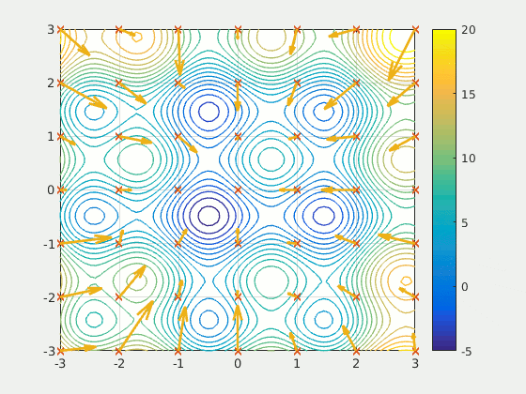
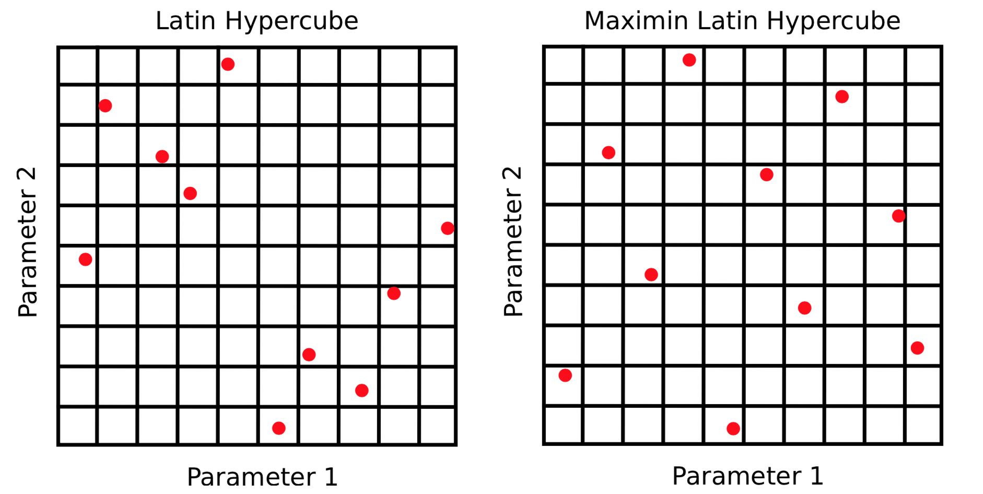
Particle Swarm Optimisation

